Slide 1
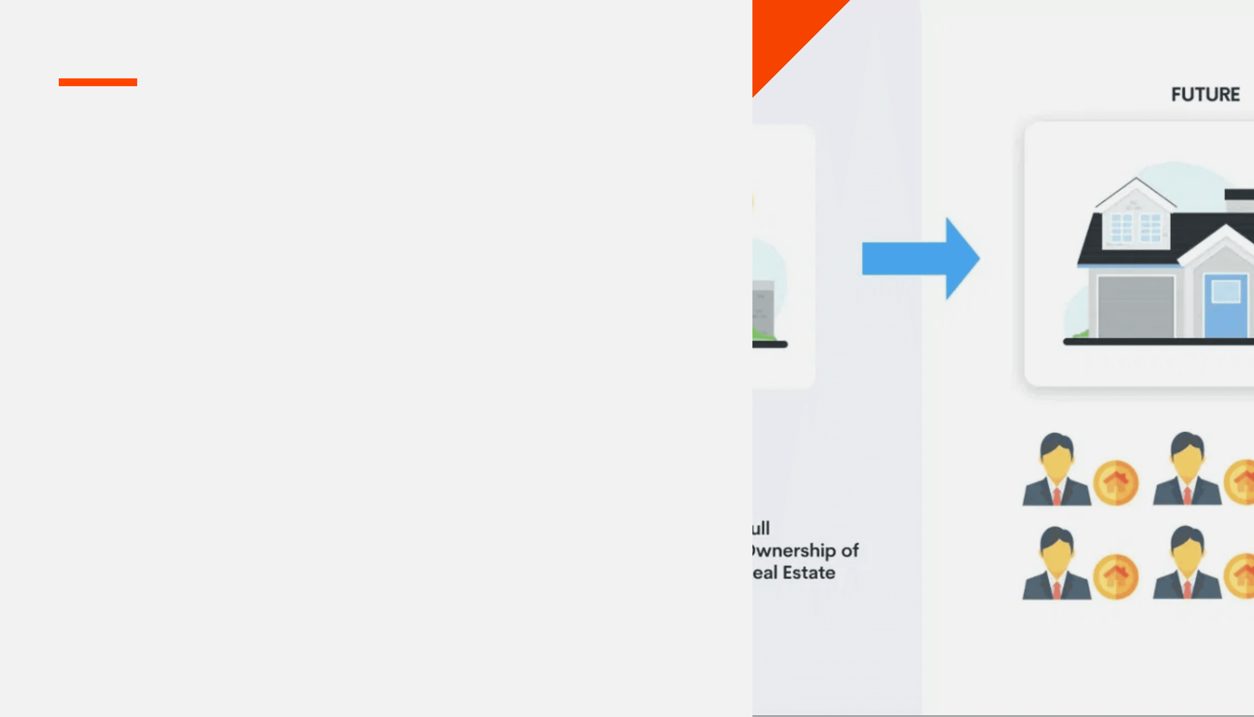
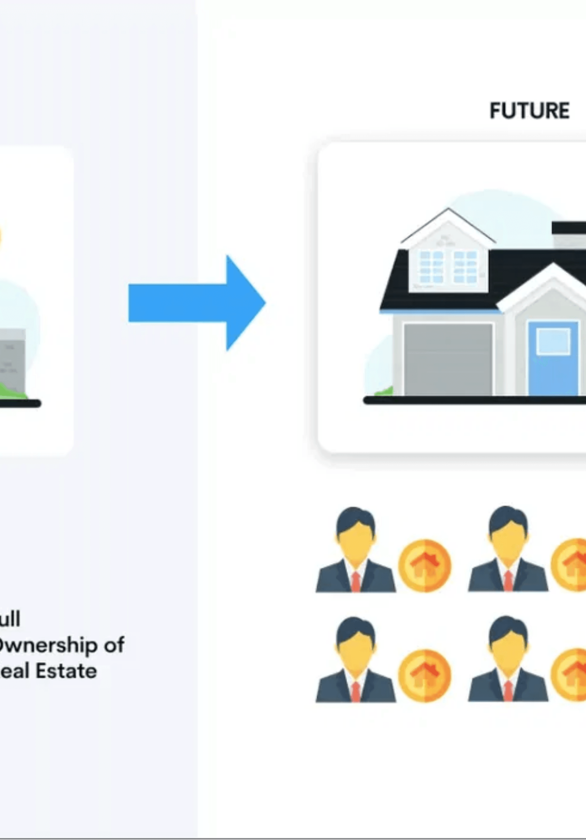


Magentic Agency Revolutionizes Access to Expertise
A marketplace where expertise, AI agents, and resources are exchanged in fractional time slices, democratizing access to high-value knowledge.
FRACTIONAL OWNERSHIP EXCHANGE
Consult experts in 10-minute increments
Fractional ownership of human & AI resources
Immediate access to closed-community assets
Win-win ecosystem for experts and users

Slide 2





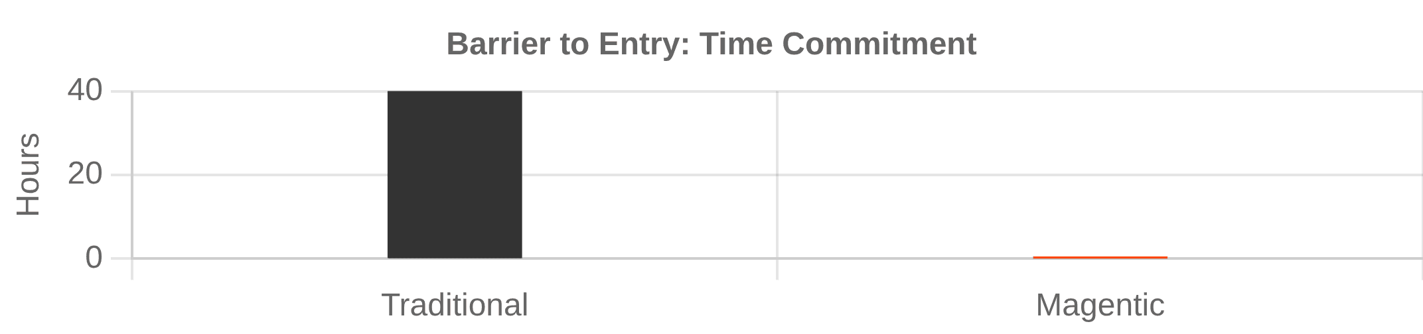
Users Access Premium Expertise Without Barriers
Micro-consultations & Community Resources
10-Minute Micro-Consultations
Book vetted experts in web dev, cloud, legal, and accounting in flexible 10-minute slices.
Closed-Community Resources
Access proprietary code, custom AI agents, and mutable applications to accelerate projects.
Cost-Effective & Flexible
Eliminate expensive retainers. Mix and match specialties to solve complex problems on demand.
Fractional Access Model: 10-Minute Slices

Slide 3
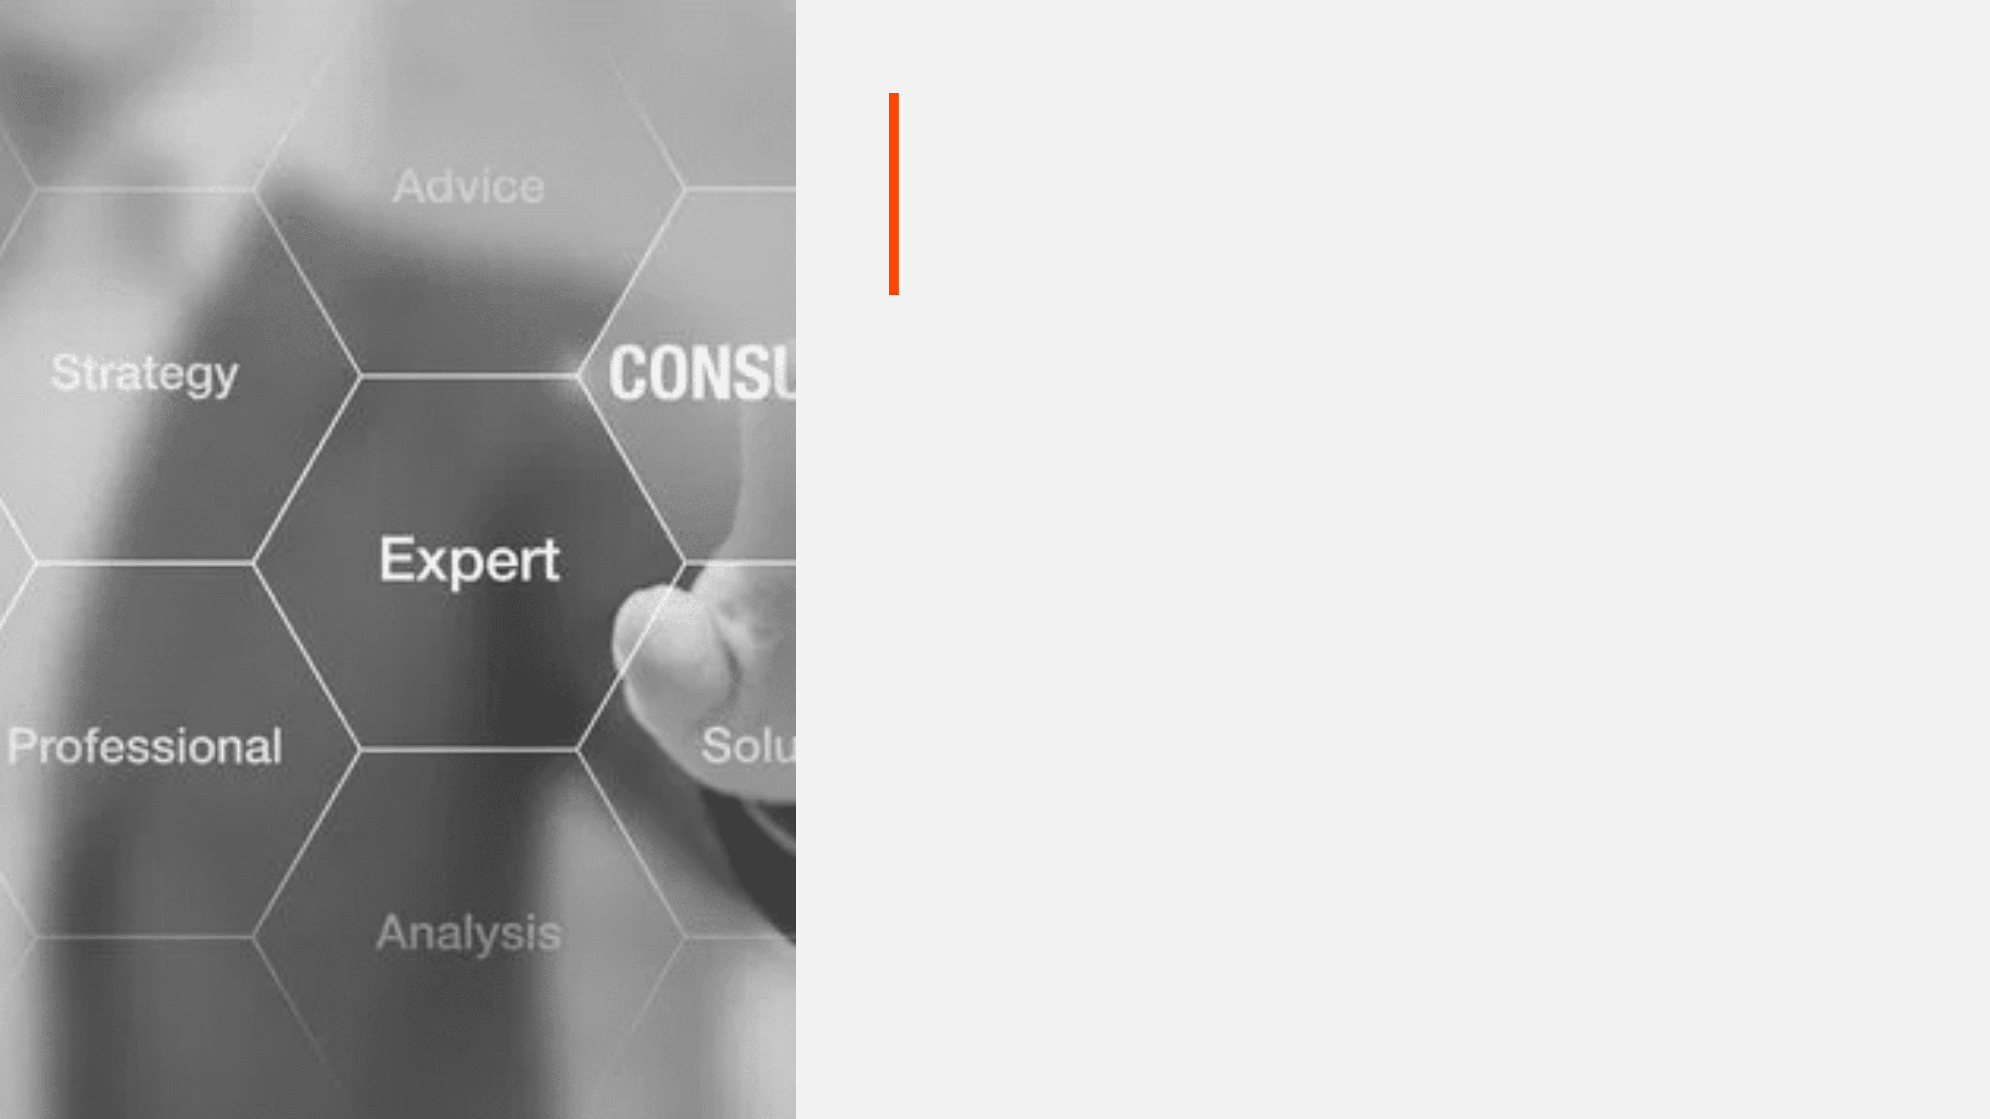





Experts Earn Reliable Income With Maximum Flexibility
Sustainable Work-Life Balance & Growth
4-Hour Work Window
Reliable Income
Commit to a manageable daily schedule. Maintain work-life balance while serving multiple clients.
Consistent bookings eliminate the feast-or-famine cycle of traditional freelancing.
Full Autonomy
Multiple Revenue Streams
Define service offerings, set availability, and manage schedules independently.
Monetize knowledge through consultations, writing, and publishing custom tools.
Daily Structure: The 4-Hour Commitment
Personal Time
4-Hour Core Work
Skill Development / Leisure

Slide 4

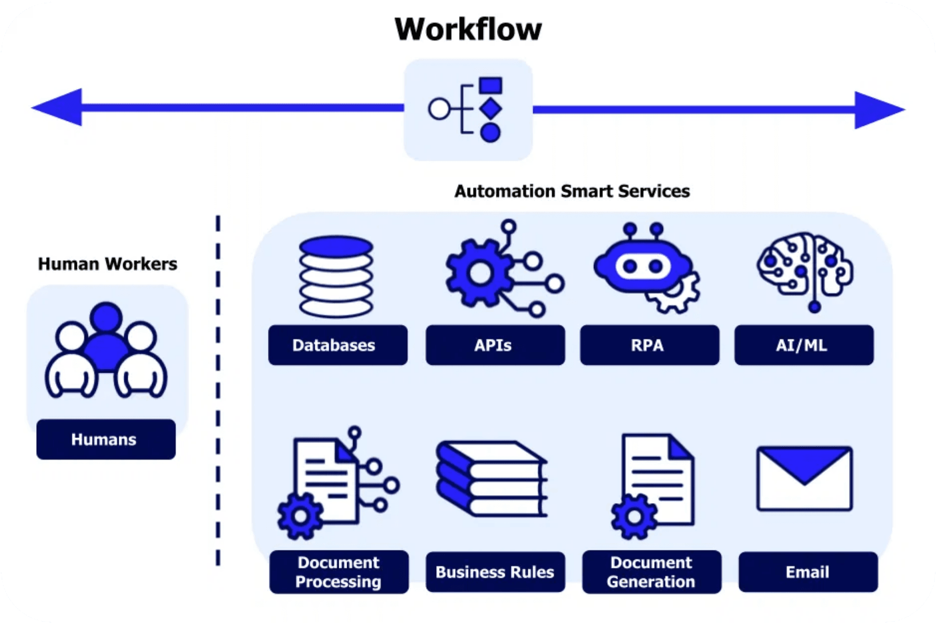




SYSTEM_ACTIVE
The Butler Expedites Exchanges Through Intelligent Automation
Proactive Matching & Frictionless Transactions
Proactive Matching
Real-time monitoring of system activity to identify optimal connections between user needs and expert availability.
Automated Execution
Handles booking, resource allocation, and transaction processing instantly, reducing friction and wait times.
Efficiency Optimization
Increases platform throughput by managing scheduling coordination without manual intervention.
FIG 4.0: AUTOMATED WORKFLOW INTEGRATION > CONNECTING HUMAN WORKERS WITH SMART SERVICES > OPTIMIZING RESOURCE ALLOCATION
Intelligent Recommendations
Analyzes historical performance data to suggest the most relevant experts and resources.

Slide 5



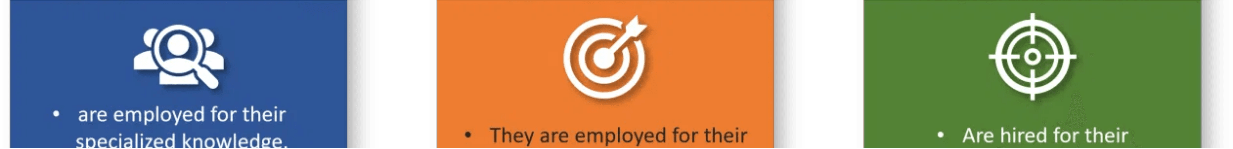
A Three-Actor Ecosystem Creates Sustainable Value
Symbiotic Growth: Users, Experts, and the Butler
Users
The Butler
Experts
Affordable, on-demand access
Intelligent matching
Reliable income stream
Solve problems faster
Automated transactions
Flexible 4-hour window
Fractional resource ownership
Maximizes platform efficiency
Multiple revenue channels
Network effects drive a self-reinforcing cycle of growth and value creation.

